Slide 1
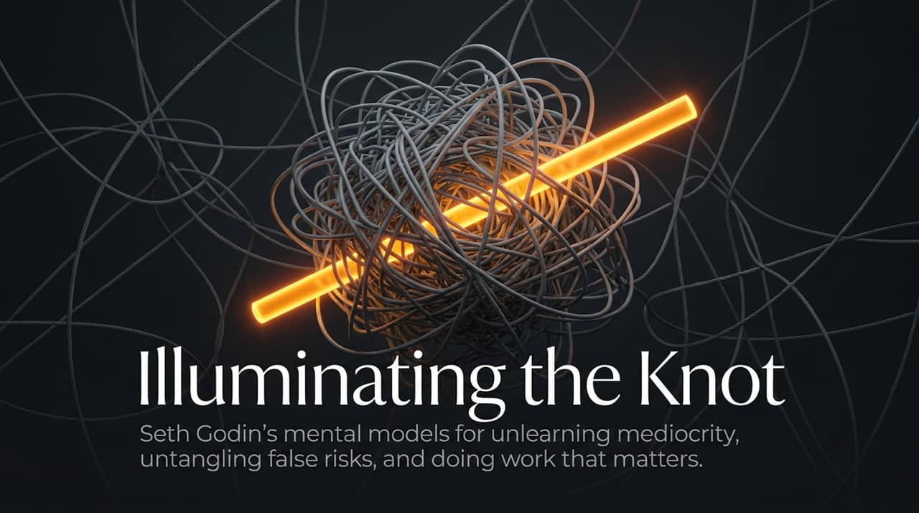
Notes:
Opener & Hook:
Welcome everyone. Today we are diving into Seth Godin’s latest framework for breaking out of modern inertia. The title of this presentation is Illuminating the Knot—a blueprint for unlearning mediocrity, untangling false risks, and doing work that actually matters. Ask yourself: How often do you feel trapped by invisible rules, expectations, or fear of failure? Today, we’re learning how to untie that knot.
Key Talking Points:
Mediocrity is an System, Not a Flaw: Mediocrity is rarely an individual character failure. It is the logical byproduct of an industrial system designed to reward conformity over original agency.
The Core Thesis: We will explore how industrial conditioning trapped us into compliant habits, how we miscalculate risk, and how returning to 'work that matters for people who care' restores our creative momentum.
Transition to Next Slide:
To understand why so many talented individuals default to staying average, we first have to examine the anatomy of the engine that built our modern workforce: The Factory.
https://youtube.com/watch?v=o8yD6nt71Cs

Slide 2
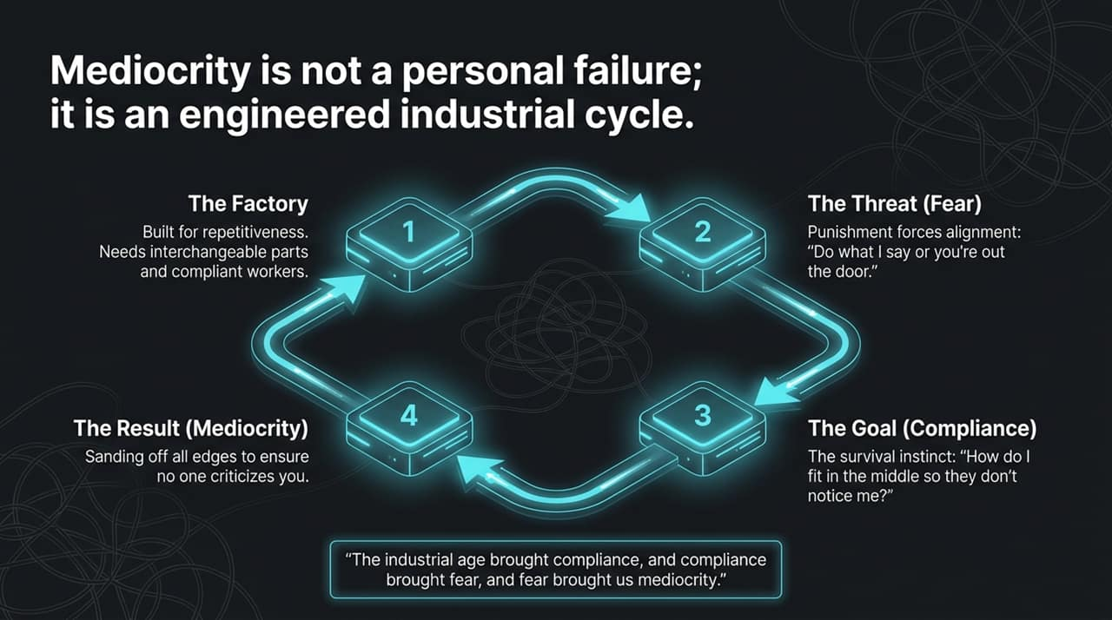
Notes:
Contextual Framing:
Let’s trace where our habits come from. As Seth notes, the industrial system gave us standard cars, affordable electronics, and global scale. But factory systems demand two things: repetitiveness and interchangeable parts.
Step-by-Step Breakdown:
The Factory: Built on assembly lines, whether in automotive plants or white-collar insurance claim processing. It requires compliant workers who fit into pre-defined roles without causing friction.
The Threat (Fear): To keep parts interchangeable, factories use fear. Do what you're told, or you’re out the door.
The Goal (Compliance): Workers adapt to survive: How do I sit safely in the middle so management doesn't single me out?
The Result (Mediocrity): To avoid criticism or risk, we sand off every sharp or unique edge of our work until it becomes completely banal.
Core Takeaway:
As Seth summarized in the interview: 'The industrial age brought compliance, and compliance brought fear, and fear brought us mediocrity.' When you default to staying invisible, you are operating as a cog in someone else's system.

Slide 3
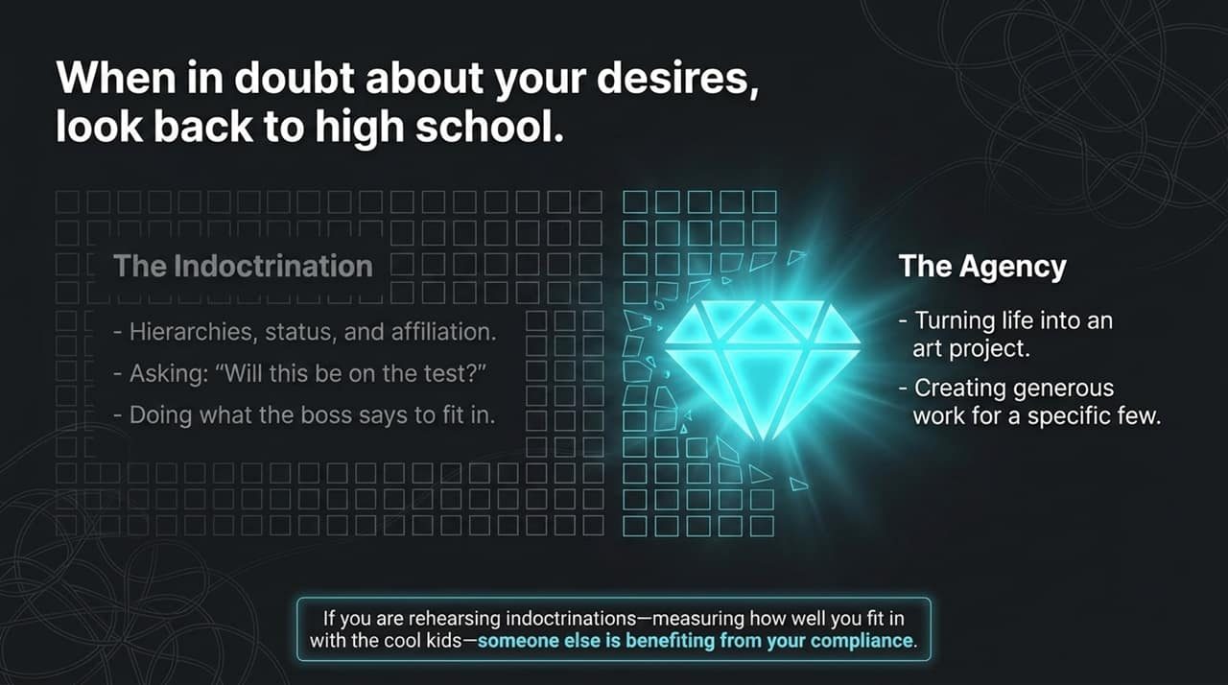
Notes:
The High School Metaphor:
When you feel uncertain about your career desires, Seth suggests looking back at high school. High school was where mass indoctrination began: learning hierarchies, chasing status, seeking affiliation, and asking the classic compliant question: 'Will this be on the test?'
Differentiating Indoctrination and Agency:
Indoctrination: Doing what the boss says solely to maintain insider status, playig social politics, and living according to someone else’s rubric.
Agency: Treating your career and life as an active art project. Stepping off the standardized track to build generous, high-value work for a targeted few.
Call to Reflection:
If you are constantly measuring how well you fit in with the 'cool kids' or corporate gatekeepers, ask yourself: Who is actually benefiting from your compliance? Usually, it’s the platform or the corporation—not you.

Slide 4
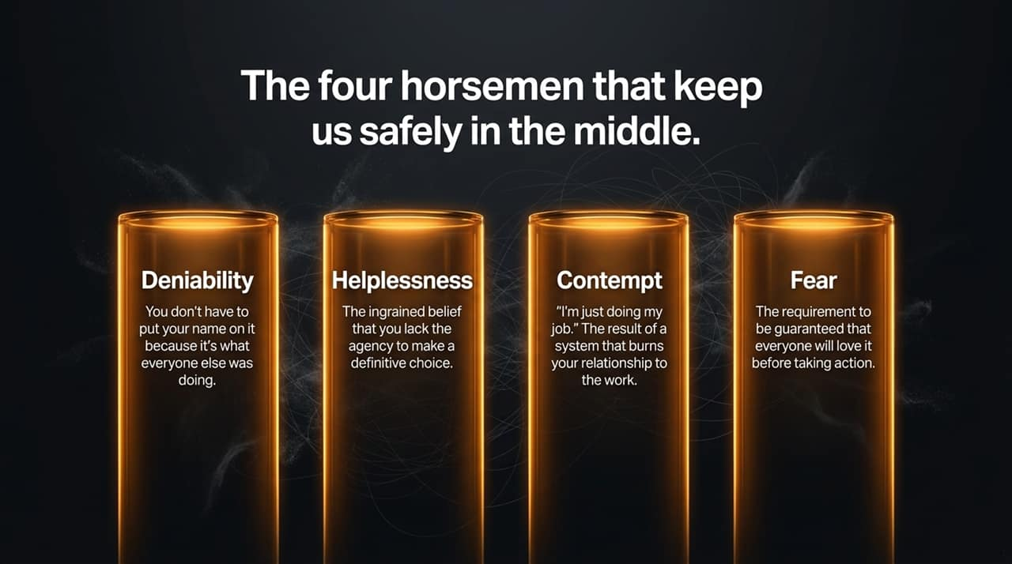
Notes:
Introduction:
What keeps us safely stuck in the average? Seth identifies four behavioral defense mechanisms—the Four Horsemen of Mediocrity.
Detailed Breakdown:
1. Deniability: Hiding behind group consensus. I don't have to put my name on this because I'm just doing what everyone else was doing.
2. Helplessness: The learned helplessness that claims you lack personal agency to make real decisions. I have no choice, I just have to do what they tell me.
3. Contempt: Disconnecting emotionally from your craft. Saying, I'm just doing my job. It’s the reaction to a toxic system that has eroded your relationship with your work.
4. Fear: Demanding a ironclad guarantee before acting—requiring reassurance that everyone will love your idea and that nothing bad will happen.
Summary:
When you demand guaranteed approval before putting work into the world, you guarantee mediocrity instead. Real creation requires acting without total certainty.

Slide 5
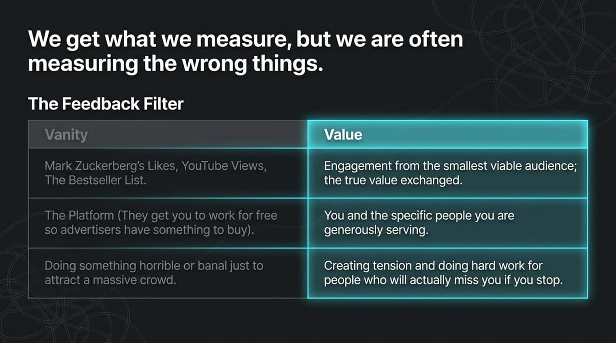
Notes:
The Problem with Easy Metrics:
We get what we measure, but most of us are measuring the wrong things. Platforms design feedback loops that serve their business model, not your personal growth.
Vanity Metrics vs. Genuine Value:
Vanity Metrics: Likes, subscriber counts, viral YouTube views, or buying a spot on a bestseller list. Mark Zuckerberg or algorithms want you hooked on these numbers so you work for free while advertisers buy attention.
True Value Metrics: Engagement, connection, and trust built with your smallest viable audience. Creating meaningful tension for people who would genuine miss your work if you stopped producing it.
Key Example:
Seth mentions going to the gym and seeing someone lean heavily on the stairmaster handles. It hurts their back and yields a worse workout, but it makes the digital step counter go up! Are you optimizing for real value, or just making your vanity metric go up?

Slide 6
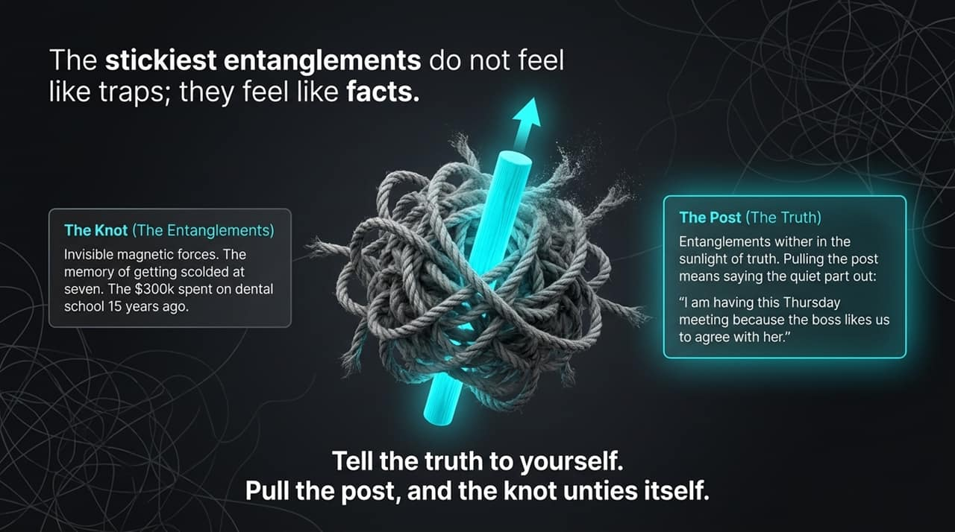
Notes:
Defining Entanglements:
The stickiest entanglements in work and life don't feel like traps—they feel like undeniable facts. Seth defines them as invisible 'spooky action at a distance'—like spending 15 years as a dentist you dislike because you spent $300,000 on dental school years ago.
The Parable of the Gordian Knot:
When Alexander faced the famous Gordian Knot in Turkey, he didn't just hack at it blindly. He noticed a central wooden post holding the structure. By pulling out the central post, the entire knot naturally unraveled.
Actionable Application:
Entanglements wither under the sunlight of truth. Pulling the post means saying the quiet truth out loud: 'We are having this 2-hour Thursday meeting because the boss likes us to sit in a circle and agree with her.' Once you name the post, you untie the knot.

Slide 7
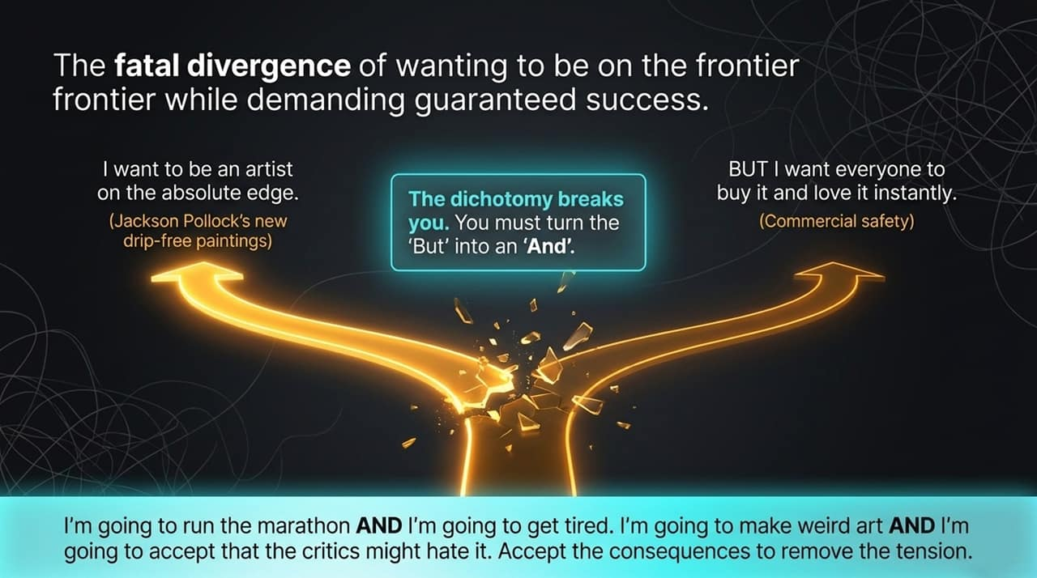
Notes:
The Conflict:
Many creators and leaders suffer from a fatal internal contradiction: wanting to produce groundbreaking work on the frontier while demanding guaranteed commercial success and immediate, universal praise.
The Cautionary Tale: Jackson Pollock:
In the 1950s, Jackson Pollock was a celebrated artist. Wanting to evolve beyond his drip paintings, he retreated to his studio and created radical new work. When showcased, critics hated it and nobody bought it. Pollock broke under the strain because he wanted both radical edge AND guaranteed sellout status.
Turning 'But' into 'And':
Replace your 'But' with 'And'. Don't say: 'I want to run a marathon BUT I don't want to get tired.' Say: 'I'm going to run the marathon AND I'm going to get tired.' 'I'm going to make weird, original art AND I accept that traditional critics might dislike it.'

Slide 8
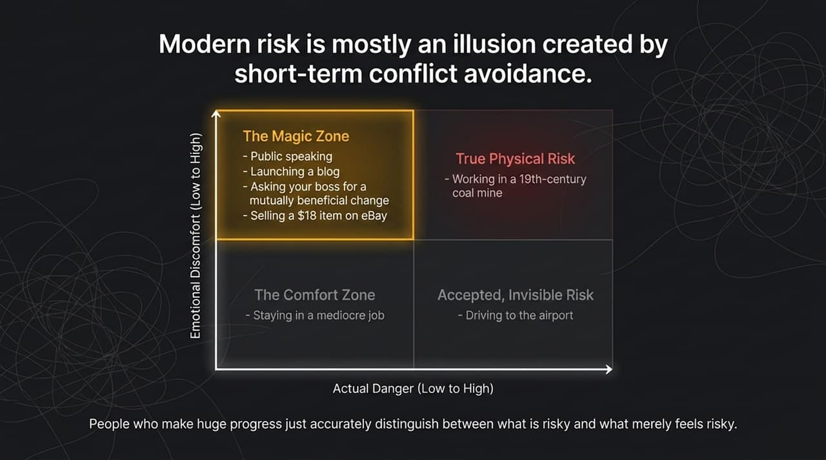
Notes:
The Illusion of Risk:
Modern risk is largely an illusion created by short-term conflict avoidance. Human evolutionary biology treats social awkwardness as a threat, but emotional friction is rarely dangerous.
Analyzing the Quadrants:
The Magic Zone (High Discomfort, Low Actual Danger): Public speaking, launching a blog, requesting a structural shift from your employer, or selling an $18 item on eBay. It feels terrifying, but the downside risk is negligible.
Accepted/Invisible Risk: Driving on a highway to the airport. Statistically far more dangerous than public speaking, yet done routinely without anxiety.
True Physical Danger: Working deep in a 19th-century coal mine.
The Comfort Zone: Remaining in a soul-crushing, stagnant job out of fear.
Takeaway:
Top performers don't necessarily possess superior courage; they simply accurately distinguish between what is genuinely risky and what merely feels risky.

Slide 9
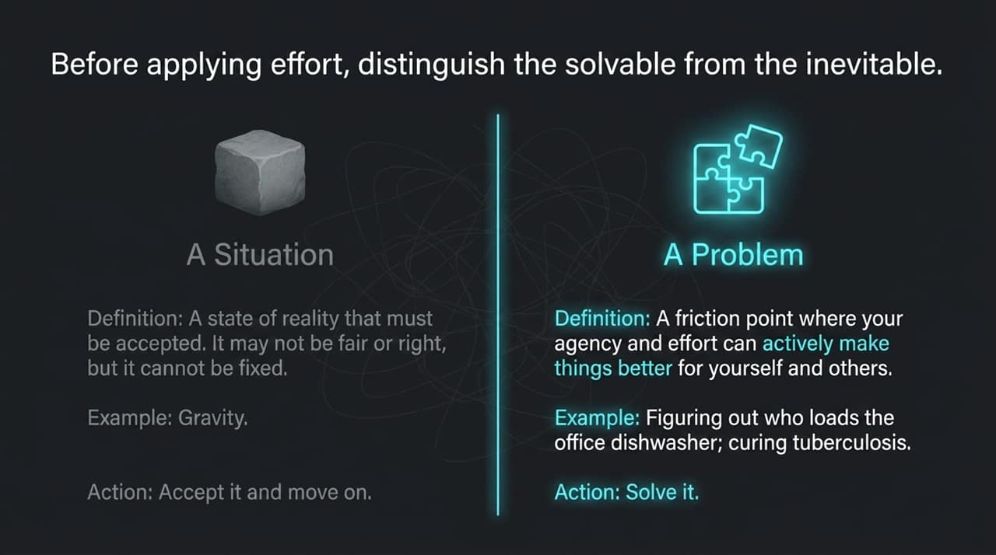
Notes:
Defining the Boundary:
Before expending mental effort, we must categorize our challenges into Situations or Problems.
Comparing Definitions:
A Situation: A reality that must be accepted. It may be uncomfortable or unfair, but it cannot be changed through personal effort. Example: Gravity or market macroeconomic shifts. Your only action is acceptance.
A Problem: A point of friction where your personal agency, trial, and iterative effort can directly yield improvement. Example: Deciding who loads the office dishwasher, curing tuberculosis, or refining product messaging. Your action is active solution.
Closing Thought:
Stop exhausting your finite capacity attempting to negotiate with gravity. Reserve your energy exclusively for problems you can solve.

Slide 10
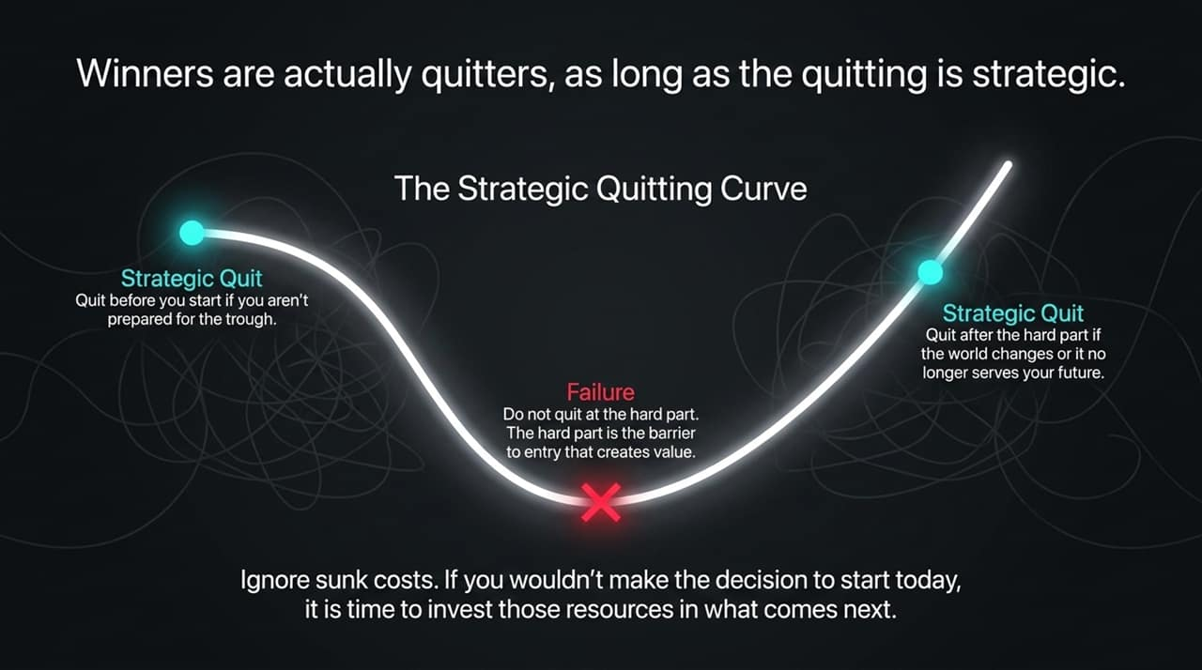
Notes:
Challenging the Stigma:
We've been fed Lombardi's line that 'winners never quit.' Seth argues the opposite: Successful innovators quit constantly, provided their quitting is strategic.
Navigating the Curve:
Quit Before You Start: If you lack the resources, stamina, or interest to survive the upcoming difficult stretch ('the dip'), quit before making the initial commitment.
Do Not Quit at the Hard Part: The hard part is the precise filter that creates market value. Quitting mid-trough is true failure.
Strategic Quit (Post-Trough): Quit after mastering a skill or overcoming a barrier if the environment shifts or if it no longer serves your future objectives.
Ignoring Sunk Costs:
Treat past investments as a generous gift from your former self. You are free to decline the gift if it no longer serves your current vision.

Slide 11
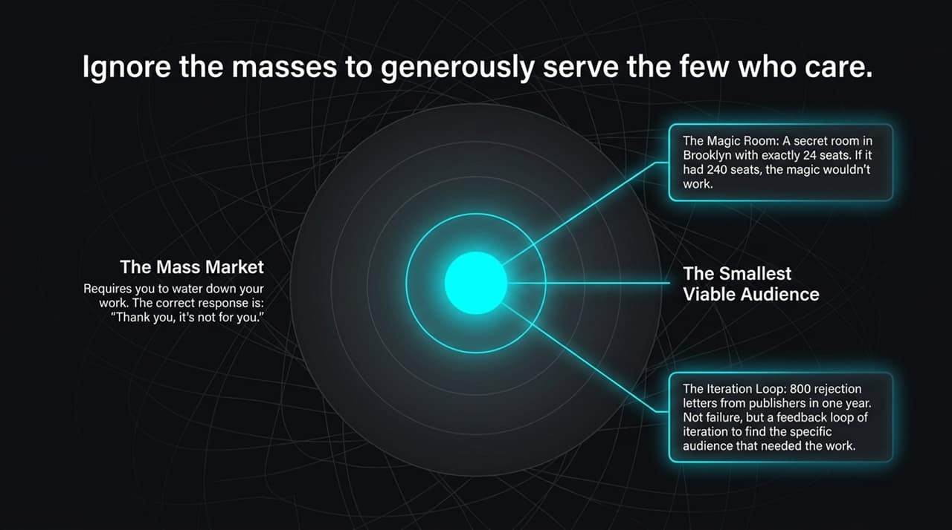
Notes:
The Fallacy of Mass Appeal:
Designing for the mass market forces you to dilute your work until it loses all distinct flavor. The internet is a terrible mass medium, but an extraordinary micro-medium.
The Magic Room Analogy:
Consider 69 Atlantic in Brooklyn—a hidden room with only 24 seats where world-class magicians perform. If you expanded it to 240 seats, the intimacy and magic would vanish completely. The constraint is the feature.
Iterative Learning:
When Seth received 800 rejection letters in one year from book publishers, it wasn't personal failure. It was an iterative loop allowing him to refine his offering until he found the specific audience that needed it. Master the phrase: 'Thank you, it's not for you.'

Slide 12
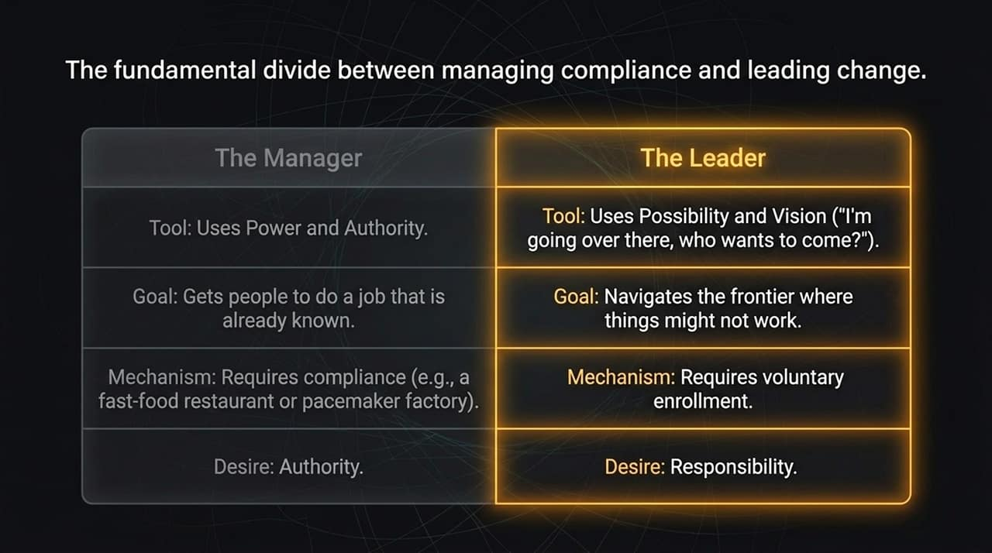
Notes:
Defining the Split:
Management and Leadership are fundamentally different operating systems.
Core Comparison:
The Manager: Leverages positional power, authority, and metrics to enforce compliance on known, repeatable tasks (e.g., fast-food chains, medical device manufacturing). Managers desire authority.
The Leader: Operates through vision, enrollment, and voluntary participation. Leaders step into uncharted territory and announce: I am going over there, who wants to come? Leaders accept responsibility.
Application:
Compliance can be mandated, but innovation, passion, and genuine craftsmanship can only be voluntarily enrolled.

Slide 13
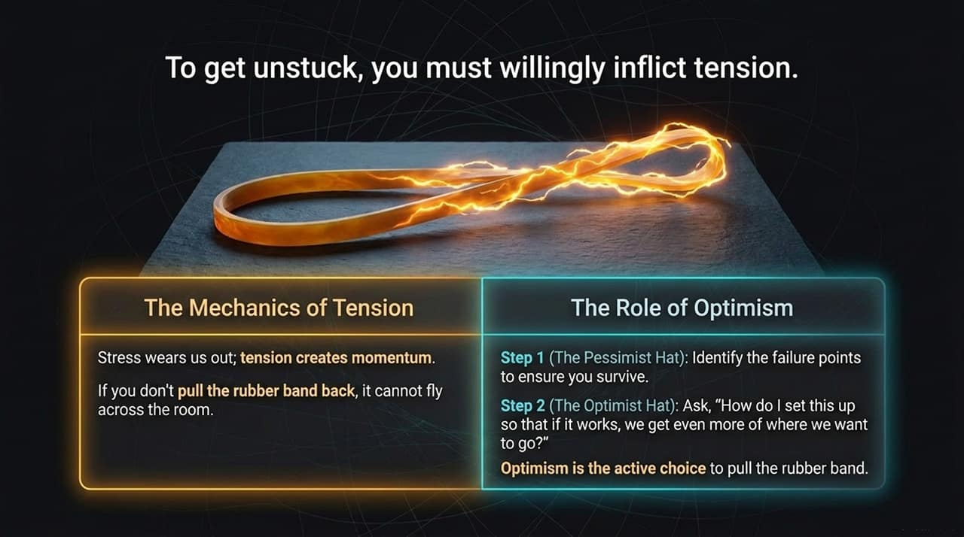
Notes:
Stress vs. Tension:
Unmanaged stress wears us out, but intentional tension builds productive momentum. Think of pulling back a rubber band: Without backward tension, it cannot fly across the room.
The 2-Step Decision Framework:
Step 1 (The Pessimist Hat): Put on your pessimist hat to rigorously audit vulnerabilities, risks, and failure points to ensure survival.
Step 2 (The Optimist Hat): Switch to your optimist hat and ask: How do we set this up so that if it works, we compound our upside?
Closing Insight:
Optimism is not naive hope; it is the strategic choice to stretch the rubber band and lead forward.

Slide 14
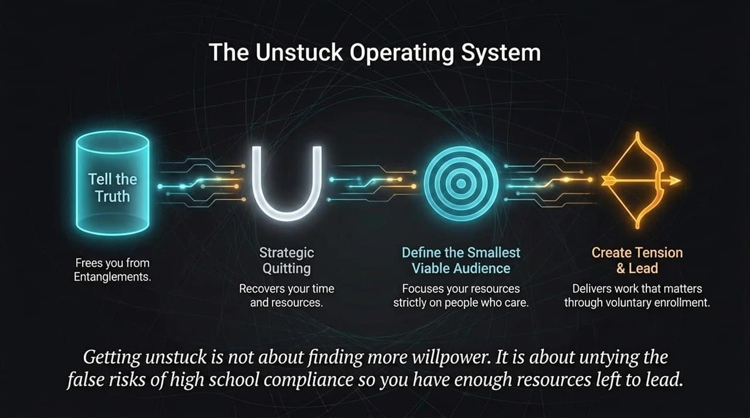
Notes:
Connecting the Engine:
Getting unstuck is not about summoning extra willpower. It requires running an integrated operating system.
Walking the Sequence:
Tell the Truth: Name the unstated posts to clear entanglements.
Strategic Quitting (U-Turn): Cut non-viable projects to reclaim time and resources.
Target SVA (Smallest Viable Audience): Direct focus solely onto those who genuinely care.
Create Tension & Lead: Mobilize your audience through voluntary enrollment.
Key takeaway:
True freedom comes from identifying false risks, abandoning legacy conditioning, and applying your remaining energy to leading others.

Slide 15
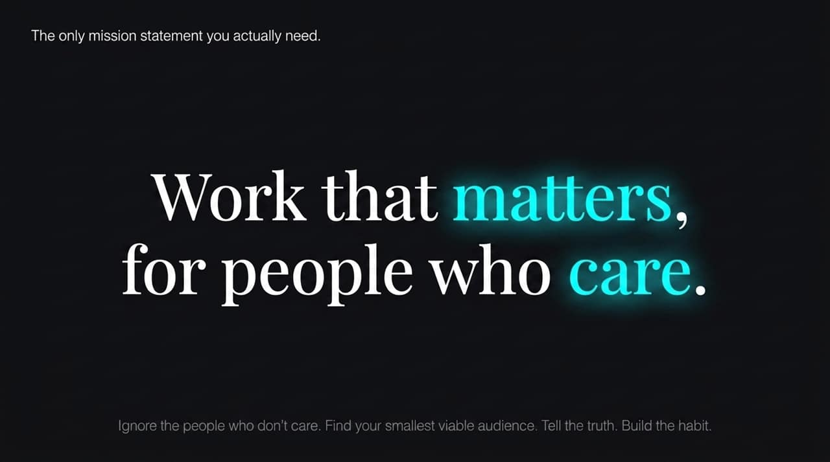
Notes:
Core Message:
Corporate mission statements are often generic paragraphs that mask basic financial motives. You only need an eight-word filter:
Deconstructing the Phrase:
Work that Matters... Craft that demands care, agency, and generous effort.
...for People Who Care. Focus strictly on those aligned with your work. Ignore uninterested critics and say, Thank you, it's not for you.
Transition to Final Slide:
Let's look at the summary architecture that brings all these principles together.

Slide 16
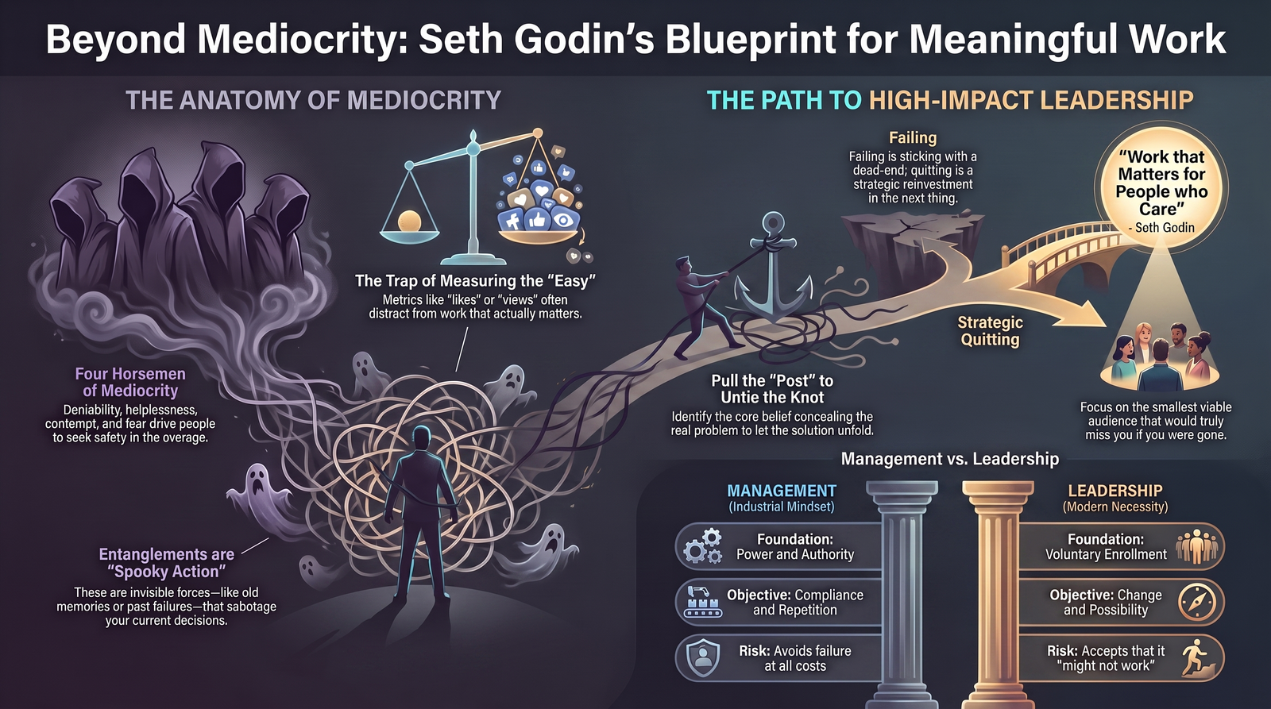
Notes:
Recap of Core Elements:
Anatomy of Mediocrity: Driven by industrial compliance, vanity metrics, invisible entanglements, and the Four Horsemen. It encourages individuals to stay hidden in safety.
Path to High-Impact Leadership: Built on pulling the post, strategic quitting, serving a smallest viable audience, and leveraging voluntary enrollment.
Final Challenge to the Audience:
Choose one area in your current work where you are prioritizing compliance over impact. Pull the post. Tell the truth. Stop attempting to please everyone and focus on producing work that matters for the people who truly care. Thank you.

